Slide 1


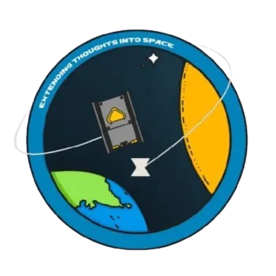







PARIKSHIT STUDENT SATELLITE
A Student-Led Space Mission from MIT MANIPAL
TASK 1 – Project Overview & Subsystem Explanation
Presented by: MURAM SIDDHARDHA REDDY
CSE 1ST Year Student

Slide 2









What is Parikshit?
Parikshit is a student satellite project at Manipal Institute of Technology (MIT), Manipal, developed by undergraduate students under faculty guidance. The team is working on designing and building a 2U nanosatellite (CubeSat class) in collaboration with ISRO and other partners.

Slide 3





Mission & Payload
Parikshit is a 2U CubeSat developed by MIT students under faculty guidance.
The satellite carries a scientific payload for hands-on learning in satellite design, data handling, and subsystem integration.
Key Points
Practical experience in satellite design and assembly
Familiarity with subsystems like ADCS, EPS, COMMS, ODHS, STMS, and Payload
Understanding mission operations and subsystem coordination

Slide 4





Team Structure
Parikshit is organized into multiple technical and management teams,
each responsible for a specific part of the satellite mission.
The project is student-led and works under the guidance of
faculty mentors and advisors.
Major Teams:
Payload
COMMS
Management and Operations
ADCS
ODHS
EPS
STMS

Slide 5


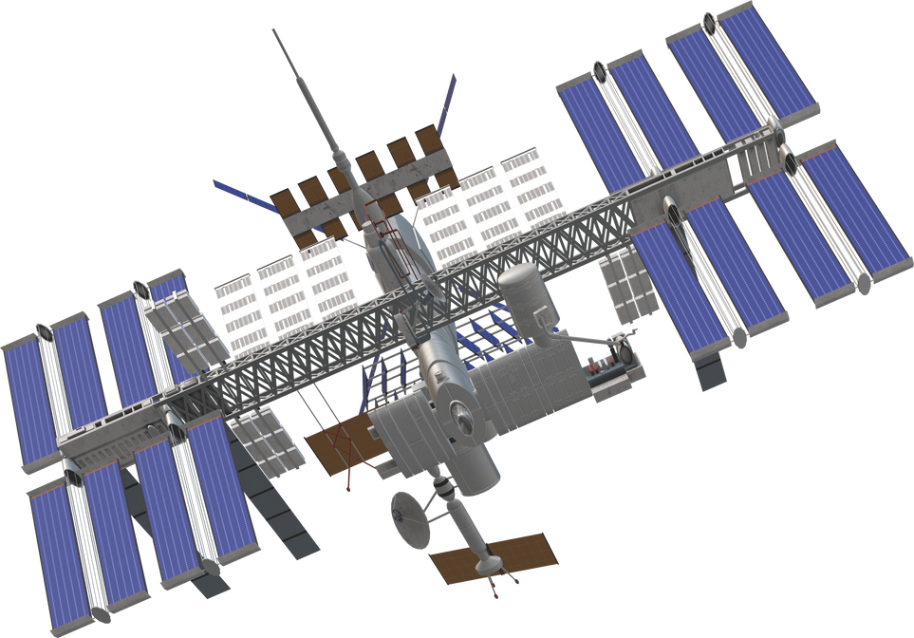
Satellite Subsystems Overview
A satellite is composed of multiple interconnected subsystems,
each performing a critical function to ensure mission success.
In Parikshit, these subsystems are designed, developed, and tested by students.
ADCS – Attitude Determination & Control System
EPS – Electrical Power System
COMMS – Communication System
ODHS – Onboard Data Handling System
STMS – Structure, Thermal & Mechanisms

Slide 6


Recognition & Mission
The Parikshit student satellite project aligns with ISRO’s student satellite initiatives,
with selected components receiving testing support from NASA facilities.
The project is guided by mentorship from experienced industry professionals.
Team members have represented Parikshit at international conferences,
interacting with astronauts such as Sunita Williams and Rakesh Sharma.
Vision is to promote student-led space innovation and contribute to the development
of India’s future space engineers.

Slide 7






Parikshit represents a student-driven initiative focused on
hands-on learning in satellite design and space systems engineering.
Presented by: MURAM SIDDHARDHA REDDY
CSE 1ST Year Student

